Slide 1

Malignant-Comments Classifier
Vandana Jain
Internship 10

Slide 2
• Business Problem Framing
The proliferation of social media enables people to express their opinions widely online. However, at the same time, this has resulted in the emergence of conflict and hate, making online environments uninviting for users. Although researchers have found that hate is a problem across multiple platforms, there is a lack of models for online hate detection.
Online hate, described as abusive language, aggression, cyberbullying, hatefulness and many others has been identified as a major threat on online social media platforms. Social media platforms are the most prominent grounds for such toxic behaviour.

Slide 3
Problem Statement
There has been a remarkable increase in the cases of cyberbullying and trolls on various social media platforms. Many celebrities and influences are facing backlashes from people and have to come across hateful and offensive comments. This can take a toll on anyone and affect them mentally leading to depression, mental illness, self-hatred and suicidal thoughts.
Internet comments are bastions of hatred and vitriol. While online anonymity has provided a new outlet for aggression and hate speech, machine learning can be used to fight it. The problem we sought to solve was the tagging of internet comments that are aggressive towards other users. This means that insults to third parties such as celebrities will be tagged as inoffensive, but “u are an idiot” is clearly offensive.

Slide 4
Objective
The objective of identification of comments are :
To give knowledge to the user about the bad comments and positive comments
To classify that comments are malignant or not.

Slide 5
Data preprocessing
convert all letters to lower/upper case
removing numbers
removing punctuation
removing white spaces
removing hyperlink
removing stop words
Word Stemming
Word lemmatization
Vectorisation

Slide 6
NAÏVE BAYS CLASSIFIER
Simple probabilistic classifier that calculates a set of probabilities by counting the frequency and combination of values in a given dataset. Represent as a vector of feature values. It is very useful to classify the comments properly. The precision and recall of this method is known to be very effective.

Slide 7

Visualization
Distribution Plot:
A distribution plot displays a distribution and range of a set of numeric values plotted against a dimension. You can display this chart in three different ways, you can just have the value points displayed showing the distribution, or you can display the bounding box which shows the range or use a combination of both.
Word Cloud:
A word cloud is a collection, or cluster, of words depicted in different sizes. The bigger and bolder the word appears, the more often it’s mentioned within a given text and the more important it is.

Slide 8
Training the model
Since the data is broken down into two modules: a
Training set and Test set, we must initially train the
model. The training set includes the target variable. The trained model is applied to test dataset and malignant comments are predicted.

Slide 9
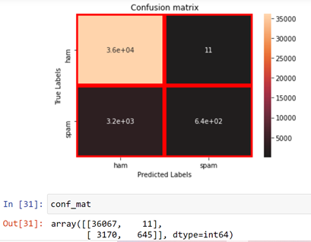
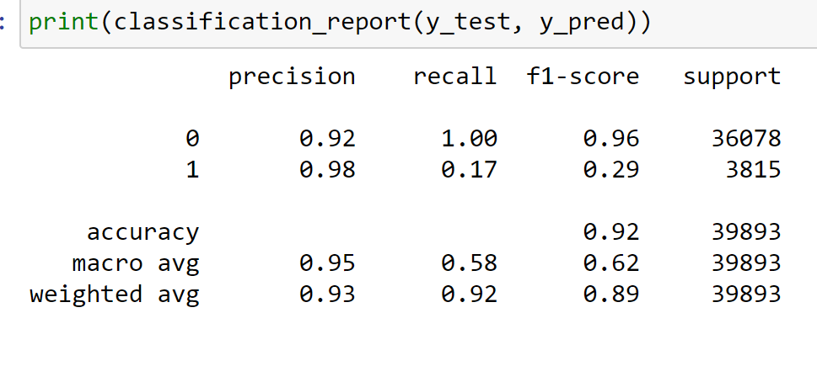
Confusion Matrix
Confusion Matrix is a very good way to understand results like true positive, false positive, true negative and so on.

Slide 10
CONCLUSION
Now that we have implemented the algorithm.
Label ‘1’ has approximately 10% records, while, label ‘0’ has approximately 90% records. Let’s have the results. We have implemented the dataset using Naive Bayes. We have the accuracy score of prediction of malignant comments is 92%.

Slide 11
Thank You

